Slide 1

FitBuddy AI
AI Fitness Plan Generator using Gemini Models
A web-based application for personalized 7-day workout plans, nutrition and recovery tips, feedback-based plan updates, and user management.
Team CIT Hackerz'26

Slide 2

1. PROJECT OVERVIEW
What FitBuddy Does
FitBuddy is a web-based AI application that generates personalized workout plans and nutrition tips.
It accepts user information such as name, age, weight, fitness goal, and workout intensity.
1
2
The system generates a structured 7-day fitness plan tailored to the selected goal and intensity.
Users can submit feedback and receive an updated plan.
3
4
SQLite + SQLAlchemy store user information and generated plans.
FastAPI provides backend routing and an interactive HTML interface.
5
6
FitBuddy AI | AI Fitness Plan Generator
2

Slide 3



2. PROBLEM STATEMENT & OBJECTIVES
Why FitBuddy, and What It Sets Out to Do
Problem / Need
Project Objectives
Generic workout routines may not match a user's goal or preferred intensity.
Generate goal-specific 7-day workout schedules.
Provide concise nutrition or recovery tips.
Users may need a simple way to revise a plan when preferences change.
Use feedback to dynamically revise plans.
Nutrition or recovery guidance can be difficult to organize alongside workouts.
Store original and updated plans for later access.
Provide both browser UI and API endpoints.
Coaches/admins need a structured view of registered users and plans.
Support local testing and deployment with FastAPI/Uvicorn.
FitBuddy AI | AI Fitness Plan Generator
3

Slide 4







3. MAJOR FEATURES
Core Functionality Documented for FitBuddy
Personalized Workout Generation
Nutrition / Recovery Tip
Feedback-Based Updating
Creates a day-wise 7-day plan.
Provides a concise tip aligned with the user's goal.
Accepts feedback such as “Add yoga” or “Include more cardio”.
User & Plan Storage
Admin View
Web Interface
Saves user details, original plan, and updated plan in SQLite.
Displays registered users and their original/updated plans.
HTML + Jinja2 pages provide an interactive workflow.
API Testing — FastAPI documentation is available at /docs.
FitBuddy AI | AI Fitness Plan Generator
4

Slide 5

4. TECHNOLOGY STACK
The Tools Behind FitBuddy
Backend & AI
Frontend & Data
Python — main programming language
HTML — user interface structure
FastAPI — web framework and API routing
CSS — responsive visual styling
Uvicorn — ASGI development server
Jinja2 — dynamic template rendering
Google Gemini — generative AI layer
SQLAlchemy — ORM/database access
Pydantic — input/data validation
SQLite — persistent local database
python-dotenv — environment variables
Git — version control prerequisite
FitBuddy AI | AI Fitness Plan Generator
5

Slide 6

5. SYSTEM ARCHITECTURE
How a Request Flows Through FitBuddy
Gemini AI
Layer
User / Browser
HTML + Jinja2
Templates
FastAPI
Routes
SQLite +
SQLAlchemy
Flow: User input → FastAPI route → Gemini generation/update → database storage → Jinja2-rendered result.
FitBuddy AI | AI Fitness Plan Generator
6

Slide 7

6. AI MODEL SELECTION
Model-Selection Details From the Project Documentation
Models Evaluated
Selected Gemini Models
T5 & BART – text generation
Gemini 1.5 Pro – documented for structured 7-day workout generation and plan updates.
DistilBERT – potential intent classification
Gemini Flash – documented for fast nutrition/recovery tips.
Bloom – general-purpose generation
Limitations included hosting/local GPU needs and additional fine-tuning or prompting for structured plans.
Reasons: API-based integration, structured formatting, low prompt-tuning needs, and fast feedback revisions.
FitBuddy AI | AI Fitness Plan Generator
7

Slide 8

7. APPLICATION WORKFLOW
Six Steps From Input to Stored Plan
1
2
3
Enter Details
Generate
View Plan
Name, User ID, age, weight, goal, intensity
FastAPI receives input and calls Gemini
7-day workout + nutrition/recovery tip
4
5
6
Give Feedback
Update
Store
User suggests changes
Original plan + feedback sent to Gemini
Updated plan saved and displayed
FitBuddy AI | AI Fitness Plan Generator
8

Slide 9
8. BACKEND & API ROUTES
Endpoints That Power the Application
/
Home route: displays the main input form.
Receives user data, generates workout plan + nutrition tip, saves data, and returns the result.
/generate-workout
/submit-feedback
Retrieves the original plan, sends feedback to the AI update function, stores the revised plan, and renders the result.
/view-all-users
Retrieves users and plans for the admin view.
FastAPI Form(...) parameters collect form inputs; Pydantic models validate the request structure. Gemini-powered functions are connected from the route handlers.
FitBuddy AI | AI Fitness Plan Generator
9

Slide 10
9. DATABASE & DATA MANAGEMENT
What FitBuddy Persists, and Why
Stored User Data
Stored Plan Data
User ID
Original AI-generated workout plan
Name
Updated plan after feedback
Age
Nutrition/recovery tip
Weight
Records are persisted in SQLite using SQLAlchemy ORM.
Fitness goal
Keeping original and updated versions supports comparison and monitoring.
Workout intensity
FitBuddy AI | AI Fitness Plan Generator
10

Slide 11
10. FRONTEND & JINJA2 TEMPLATES
The Pages Behind the User Experience
index.html
result.html
all_users.html
Collects user details and submits them to the workout-generation route.
Displays user information, the AI-generated 7-day plan, nutrition tip, and feedback form.
Provides the admin view of users and their plans.
Jinja2 TemplateResponse binds backend values such as username, goal, intensity, workout_plan, and nutrition_tip.
CSS uses Flexbox, responsive media queries, rounded inputs, shadows, hover effects, and a fitness-oriented visual theme.
FitBuddy AI | AI Fitness Plan Generator
11

Slide 12
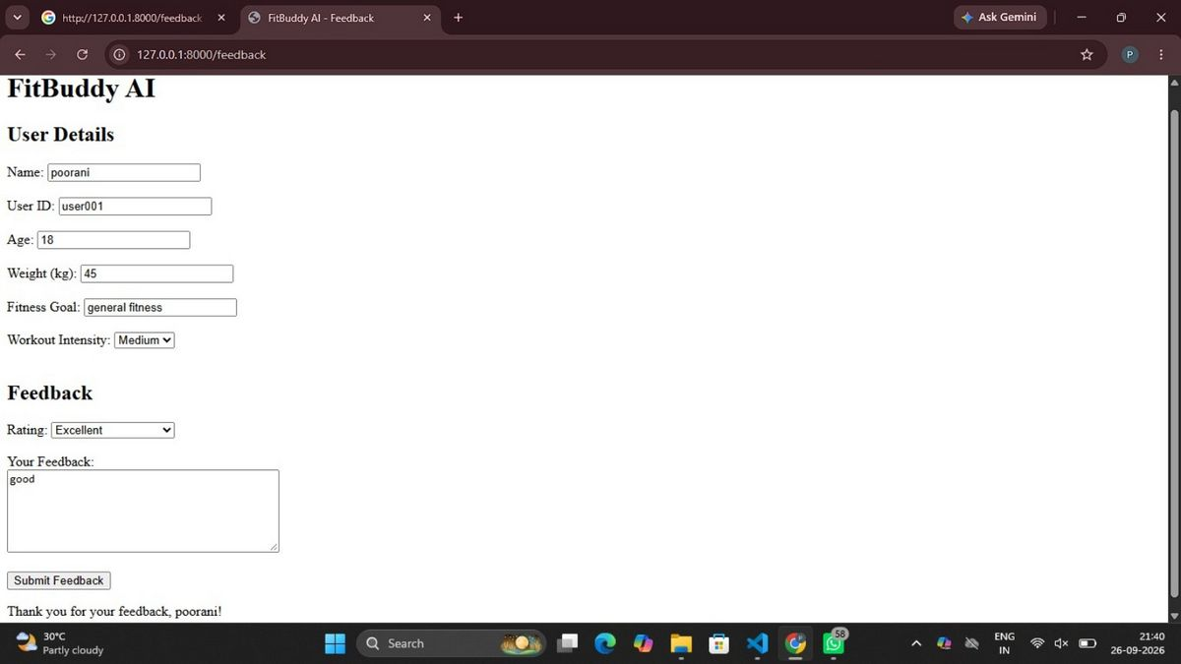
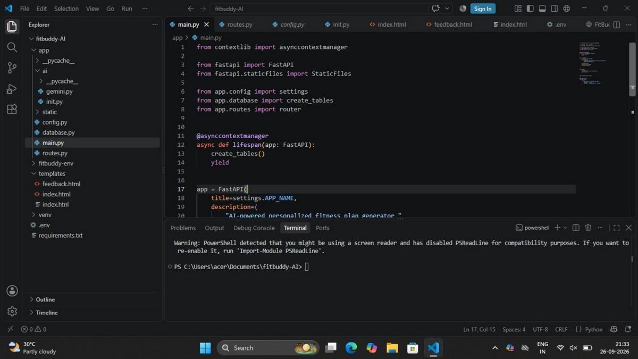
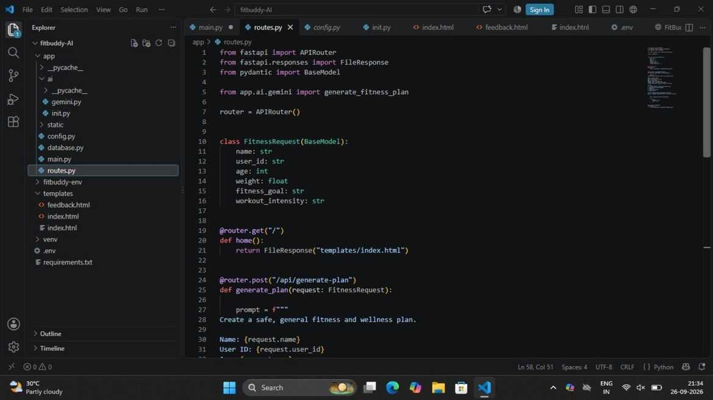
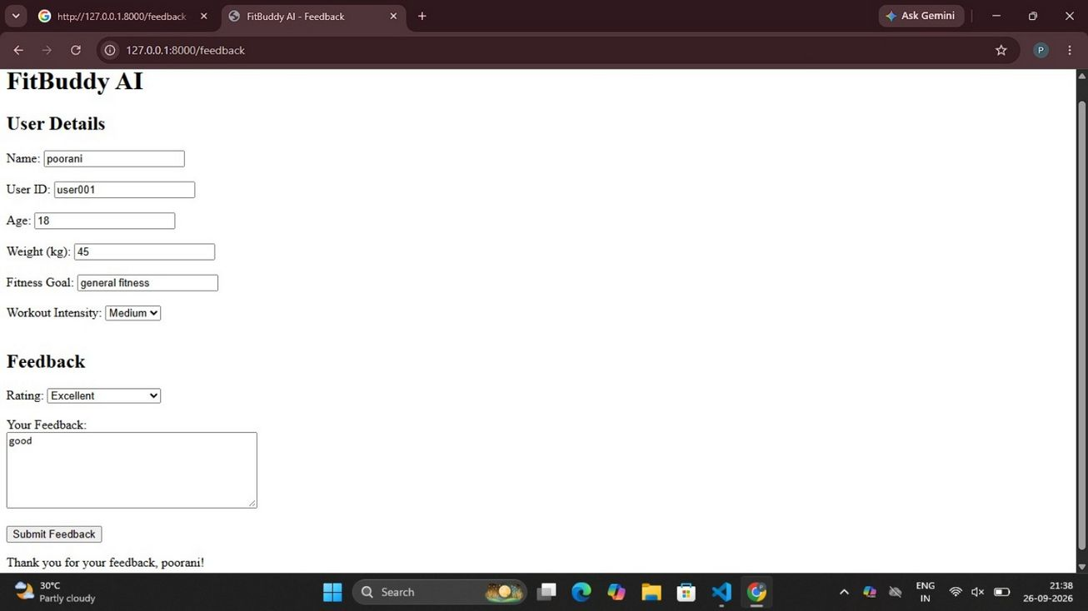
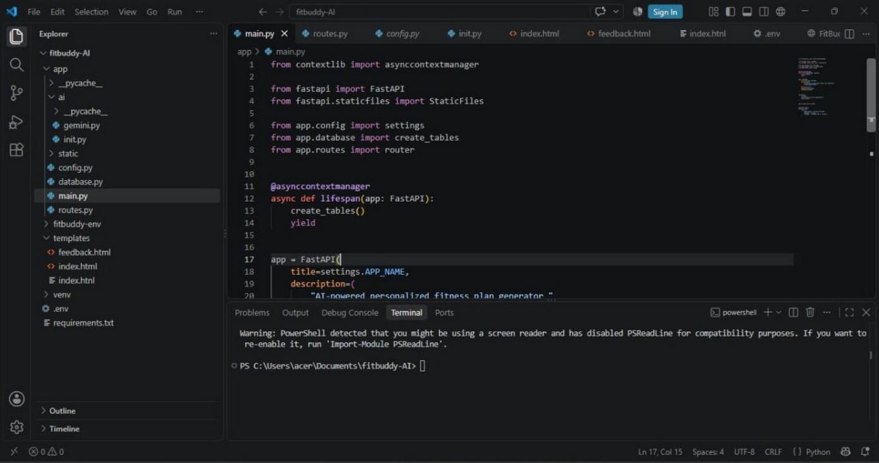
11. PROJECT SCREENSHOTS
Actual Screens From the Submitted Project
FastAPI main.py
routes.py
main.py configuration
HTML input interface code
Running Feedback page
FitBuddy AI | AI Fitness Plan Generator
12

Slide 13
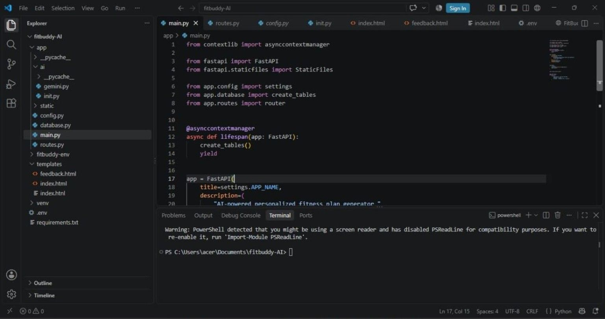
12. WORKING DEMO — FEEDBACK PAGE
A Closer Look at the Feedback Flow
User details are displayed on the page.
Feedback section provides a rating and text box.
After submission, a confirmation message is shown.
This demonstrates the feedback stage of the documented workflow.
The submitted screenshot shows the application running locally at 127.0.0.1:8000/feedback.
Running locally at 127.0.0.1:8000/feedback
FitBuddy AI | AI Fitness Plan Generator
13

Slide 14
13. SETUP & LOCAL DEPLOYMENT
Getting FitBuddy Running on Your Machine
Create a virtual environment
python -m venv venv
1
Windows activation
venv\Scripts\activate
2
Install dependencies
pip install -r requirements.txt
3
Configure the Gemini API key
Store it in an environment variable or .env file; do not expose the key in source code.
4
Start the FastAPI server
uvicorn app.main:app --reload
5
Open the app / view docs
http://127.0.0.1:8000 • interactive docs at /docs
6
FitBuddy AI | AI Fitness Plan Generator
14

Slide 15
14. TESTING & VERIFICATION
Confirming FitBuddy Works End to End
Functional Checks
Verification Points
Home page loads and accepts required user details.
Run the app locally with Uvicorn.
Workout generation route processes the input.
Check browser pages through 127.0.0.1:8000.
AI output is displayed in the result page.
Use /docs to inspect/test API endpoints.
Nutrition/recovery tip is displayed with the plan.
Verify original and updated plans in the admin view.
Feedback can be submitted to request a revised plan.
Check that environment variables are configured correctly.
Updated data is stored in the database.
Confirm the database persists records.
FitBuddy AI | AI Fitness Plan Generator
15

Slide 16
15. PROJECT SCENARIOS / USE CASES
How Different Users Experience FitBuddy
Scenario 1 — Personalized Plan
Scenario 2 — Feedback Update
User enters goal and intensity and receives a 7-day plan.
User requests changes such as more cardio or more rest days; the plan is regenerated.
Scenario 3 — Nutrition / Recovery
Scenario 4 — Admin / Coach
User receives a concise tip aligned with the selected fitness goal.
An authorized admin or coach can view users, original plans, and updated plans.
FitBuddy AI | AI Fitness Plan Generator
16

Slide 17

16. FUTURE SCOPE
Where FitBuddy Could Go Next
Extend the application from local deployment to a cloud deployment.
Add stronger authentication and role-based access for admin/coach features.
Add richer progress tracking and visual analytics.
Expand personalization using additional user preferences and workout history.
Add more AI-supported wellness features while keeping the existing FastAPI + Gemini architecture.
Improve UI/UX with richer dashboards and mobile-first components.
FitBuddy AI | AI Fitness Plan Generator
17

Slide 18
17. CONCLUSION
Bringing It All Together
FitBuddy combines FastAPI, Gemini AI, Jinja2, SQLAlchemy, and SQLite into one web-based fitness planning application.
It generates personalized 7-day plans, nutrition/recovery tips, and feedback-based updates.
The application demonstrates an end-to-end flow from user input to AI generation, storage, and web presentation.
The project also provides an admin view for monitoring original and updated plans.
Overall, the documented system demonstrates how generative AI can be integrated into a practical wellness-oriented web application.

Slide 19
THANK YOU
FitBuddy AI – Personalized Fitness Plan Generator

